Slide 1


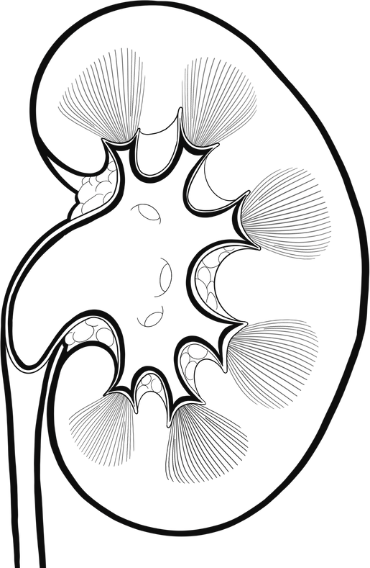
CHRONIC KIDNEY DISEASE ANALYSIS
Presented by Sudabathula Dhira

Slide 2

Problem
Statement
To develop a machine learning model that predicts the presence or absence of Chronic Kidney Disease (CKD) using clinical and laboratory features, enabling early detection and risk stratification for timely intervention. This involves:
Identifying key predictors of CKD (e.g., creatinine, GFR, BUN, age, diabetes, hypertension).
Building and evaluating a Random Forest classifier to accurately predict CKD status.
1. Interpreting the model to highlight the most influential features for clinical relevance and decision-making.

Slide 3


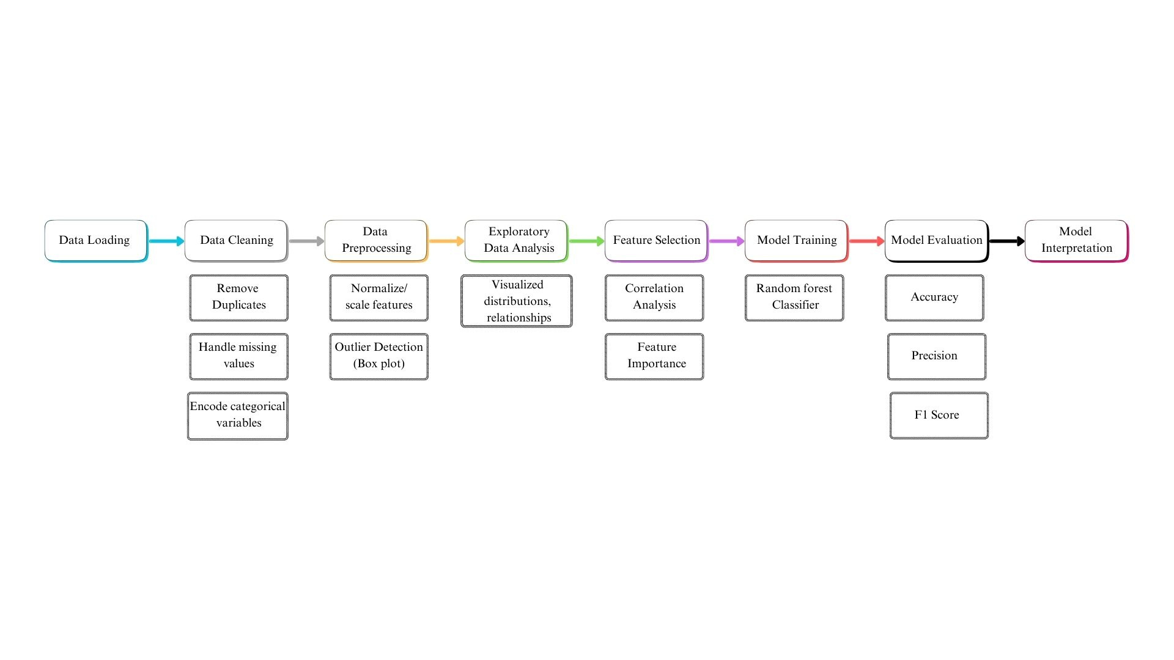
Work flow

Slide 4

Insights:
Feature Importance
Data Quality and cleaning
Model Performance
Clinical Relevance
Outlier Detection
Scalability and Deployment

Slide 5
Model Training
01.
02.
03.
Algorithm Used
Training Process
Key parameters
Random Forest Classifier, which is robust and effective for classification tasks.
The model was trained on the preprocessed and feature-selected training dataset. The Random Forest algorithm builds multiple decision trees and aggregates their predictions to improve accuracy and reduce overfitting.
The model was initialized with parameters like n_estimators (number of trees), max_depth (maximum depth of trees), and others to optimize performance.

Slide 6
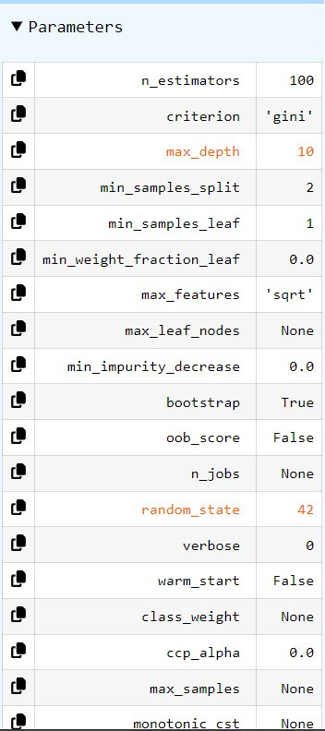
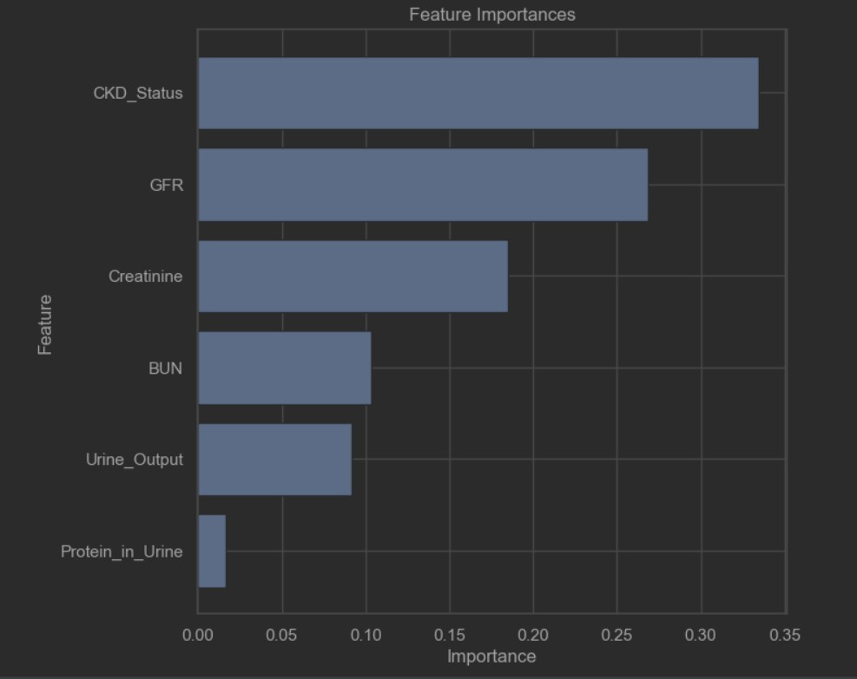

Slide 7

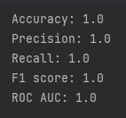
Results
The Random Forest model achieved high accuracy, precision, recall, and ROC-AUC, demonstrating its effectiveness in predicting CKD.
01.
02.
The model was evaluated using cross-validation to ensure robustness and avoid overfitting.

Slide 8


Thank you very much!
Click here for code
https://github.com/DhiraSudabathula/Chronic-Kidney-Analysis

